Slide 1
ASSISTED LIVING PROJECT
RITWIK DUTTA

Slide 2
OVERVIEW OF CURRENT WORK
End user goes to the root website and clicks authorize
Frontend OAuth2 implementation flow redirects to Jawbone account login
Redirected temporary authentication token sent to server side Python CGI script
Script requests data from API by including Authentication tokens in the header
Script returns relevant data to JavaScript to be formatted and displayed

Slide 3

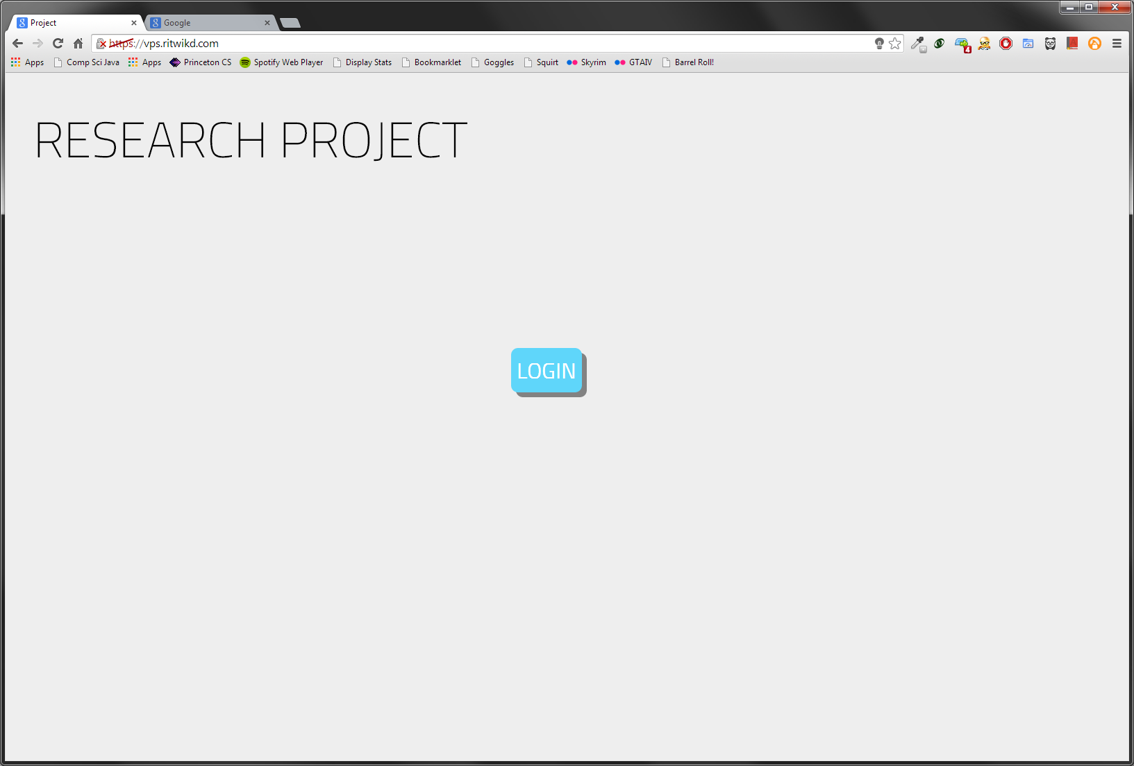
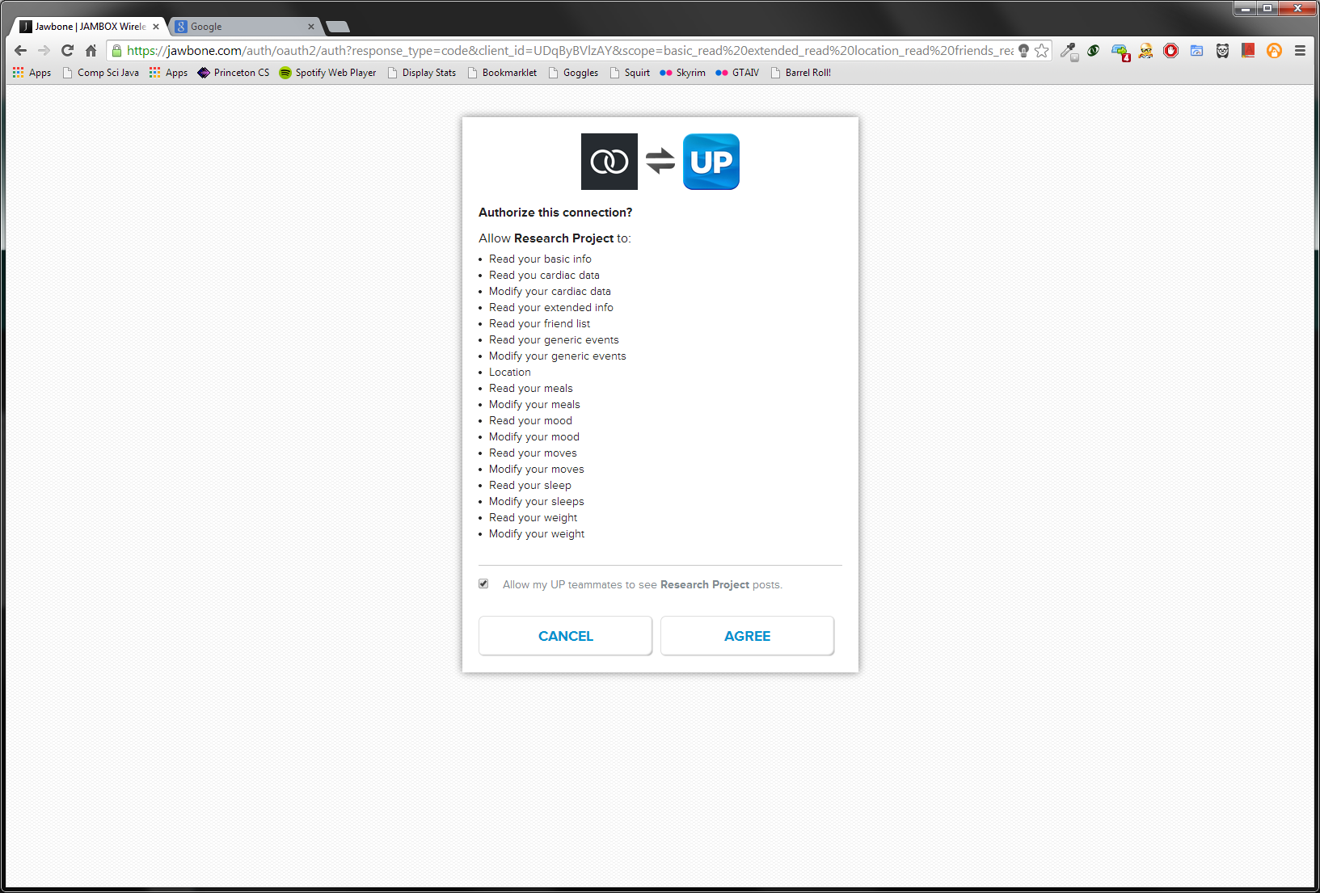


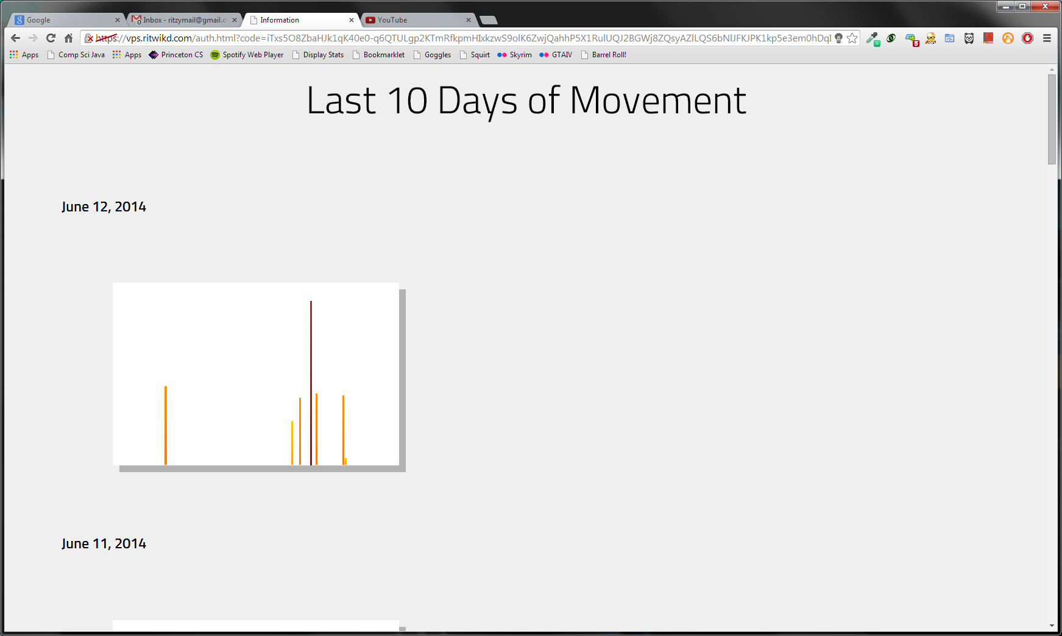
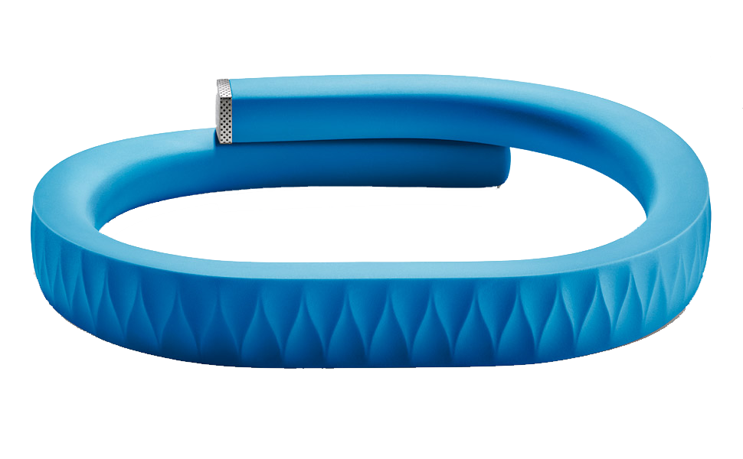
PROJECT FLOW
AUTHORIZE
CONNECTION
CARETAKER
PATIENT

Slide 4
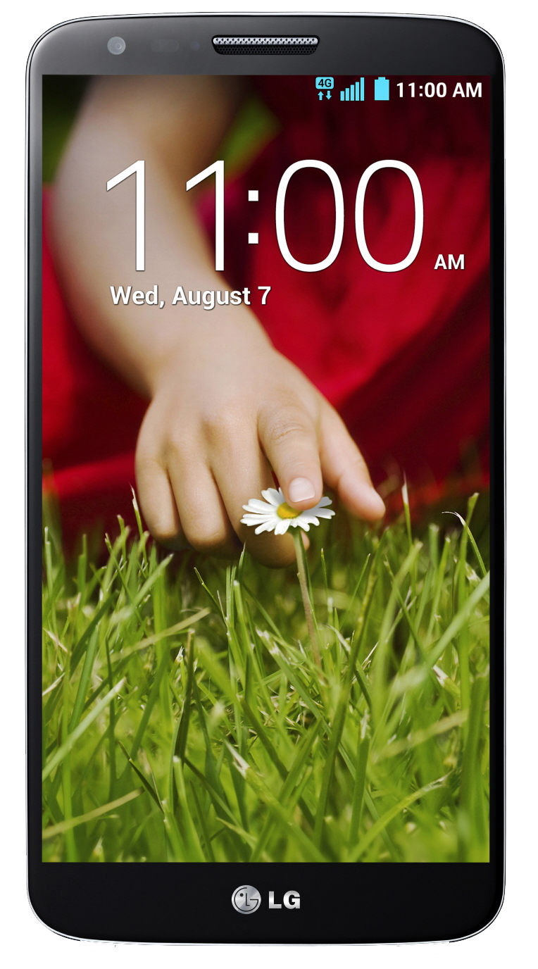
PART I - PATIENT SETUP
Patient wears Jawbone UP24 device on wrist
Patient carries smartphone in pocket (LG G2 or phone with equivalent battery life suggested)
Wristband has an approximate battery life of 1 week
Phone has an approximate battery life of 12-15 hours (depending on model)
Data is synced every 20 minutes

Slide 5
PART II - CARETAKER SETUP
Caretaker needs to charge phone and band at daily and weekly intervals, respectively
Caretaker needs to manage Jawbone UP24 account
Caretaker needs to login to monitoring website

Slide 6
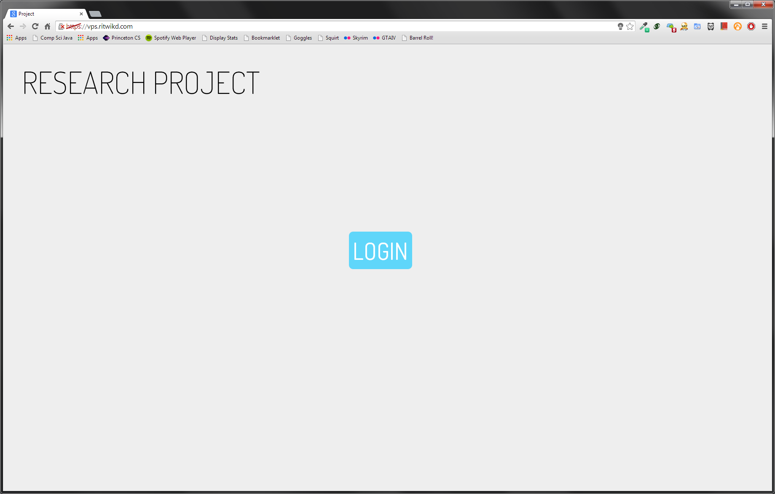
PART 1 - WEBSITE LOGIN
Simple interface
Single button, “LOGIN”
Redirects to Jawbone authentication page
Starts OAuth implementation flow

Slide 7
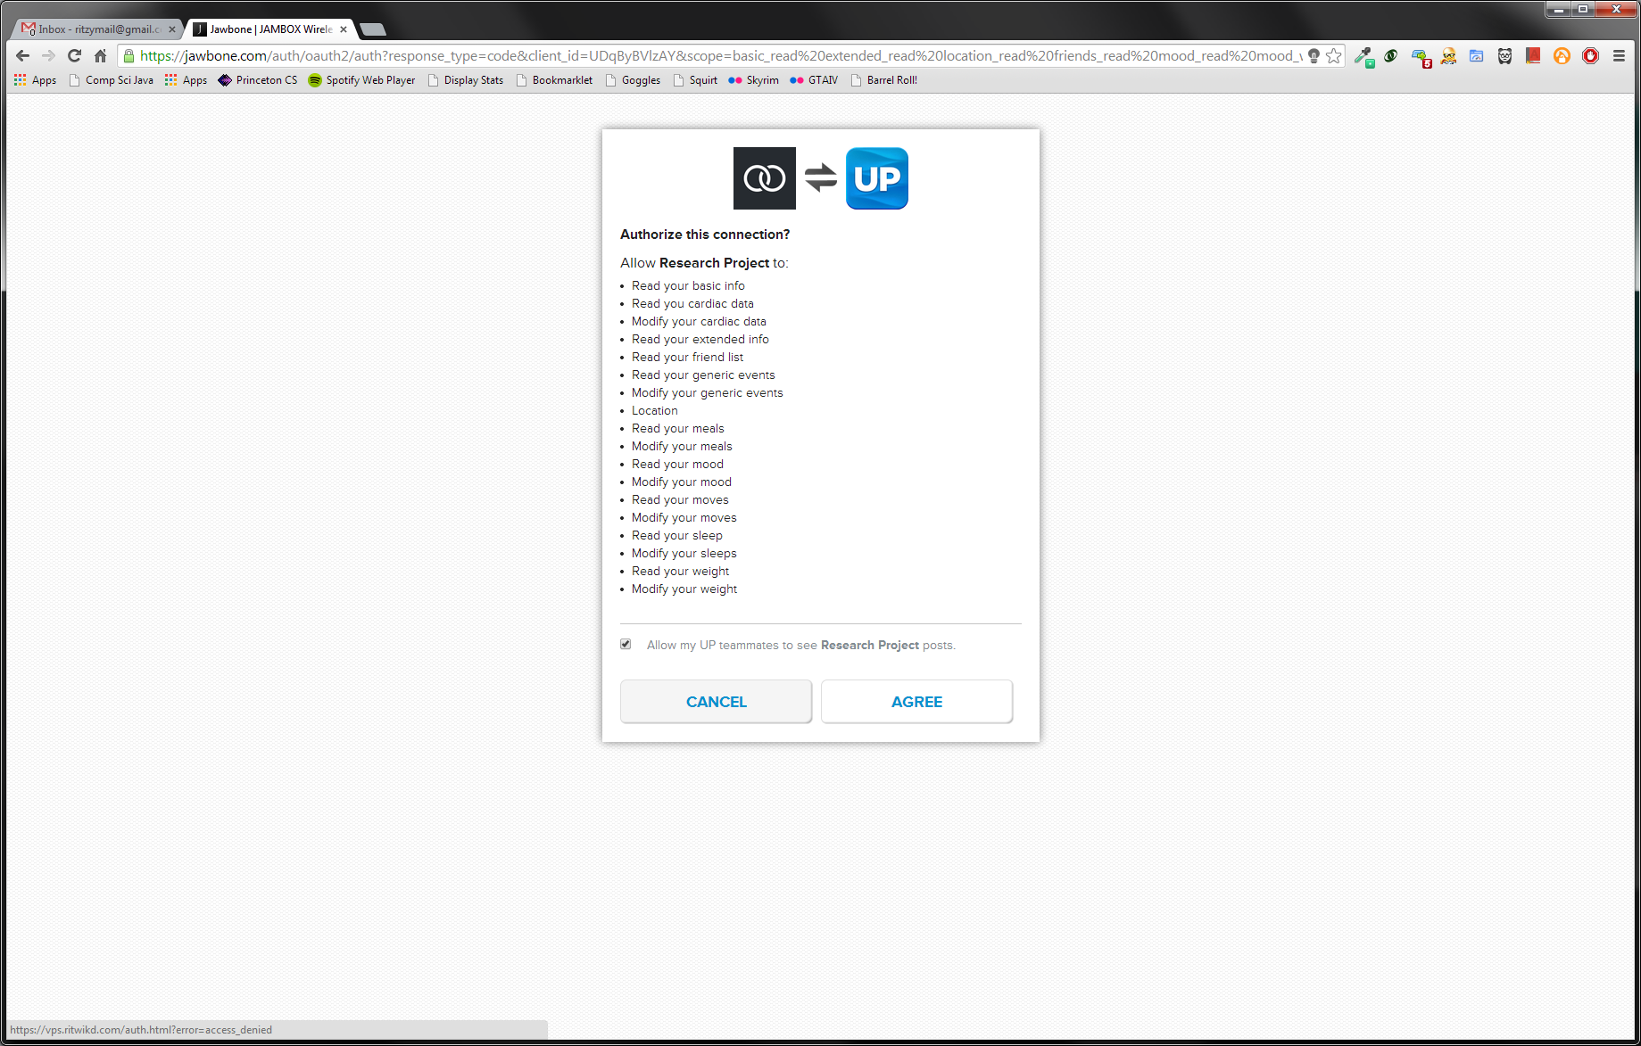
PART 2 – JAWBONE AUTHENTICATION
Jawbone authentication page
Requires Jawbone account
Returns temporary authentication token
Callback required to be https://
Current certificate self-generated
Not trusted by default
Callback page sends OAuth2 GET request to Jawbone server to get user authorization code

Slide 8
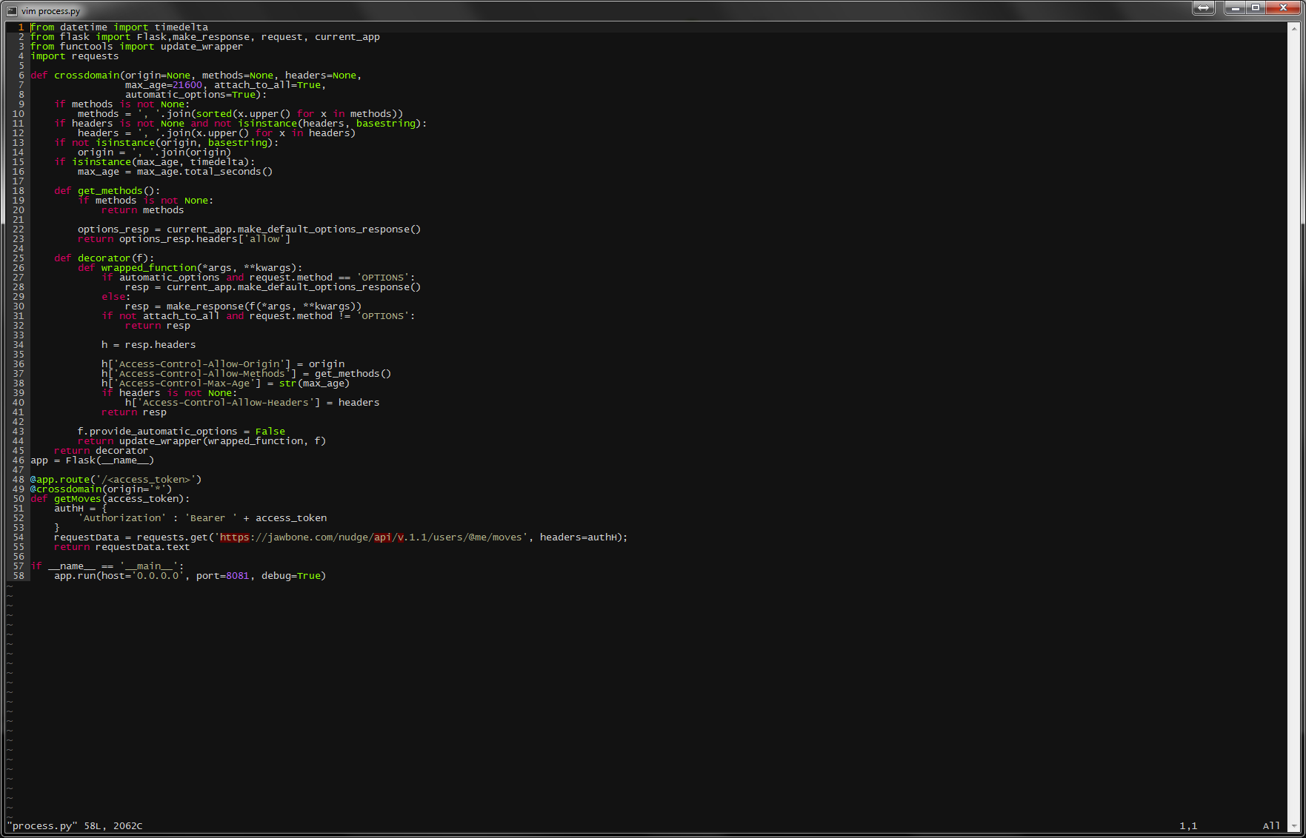
PART 3 – SERVER AND API REQUESTS
Currently using Flask web framework. Planned move to either Django or Pylons web framework.
Callback page sends GET request to project server with user auth. token
Script requests data from API with user auth. token in authorization header
Script receives JSON object from API and returns to callback page
In future, data processing will be offloaded to server-side script to remove client-side limitations

Slide 9
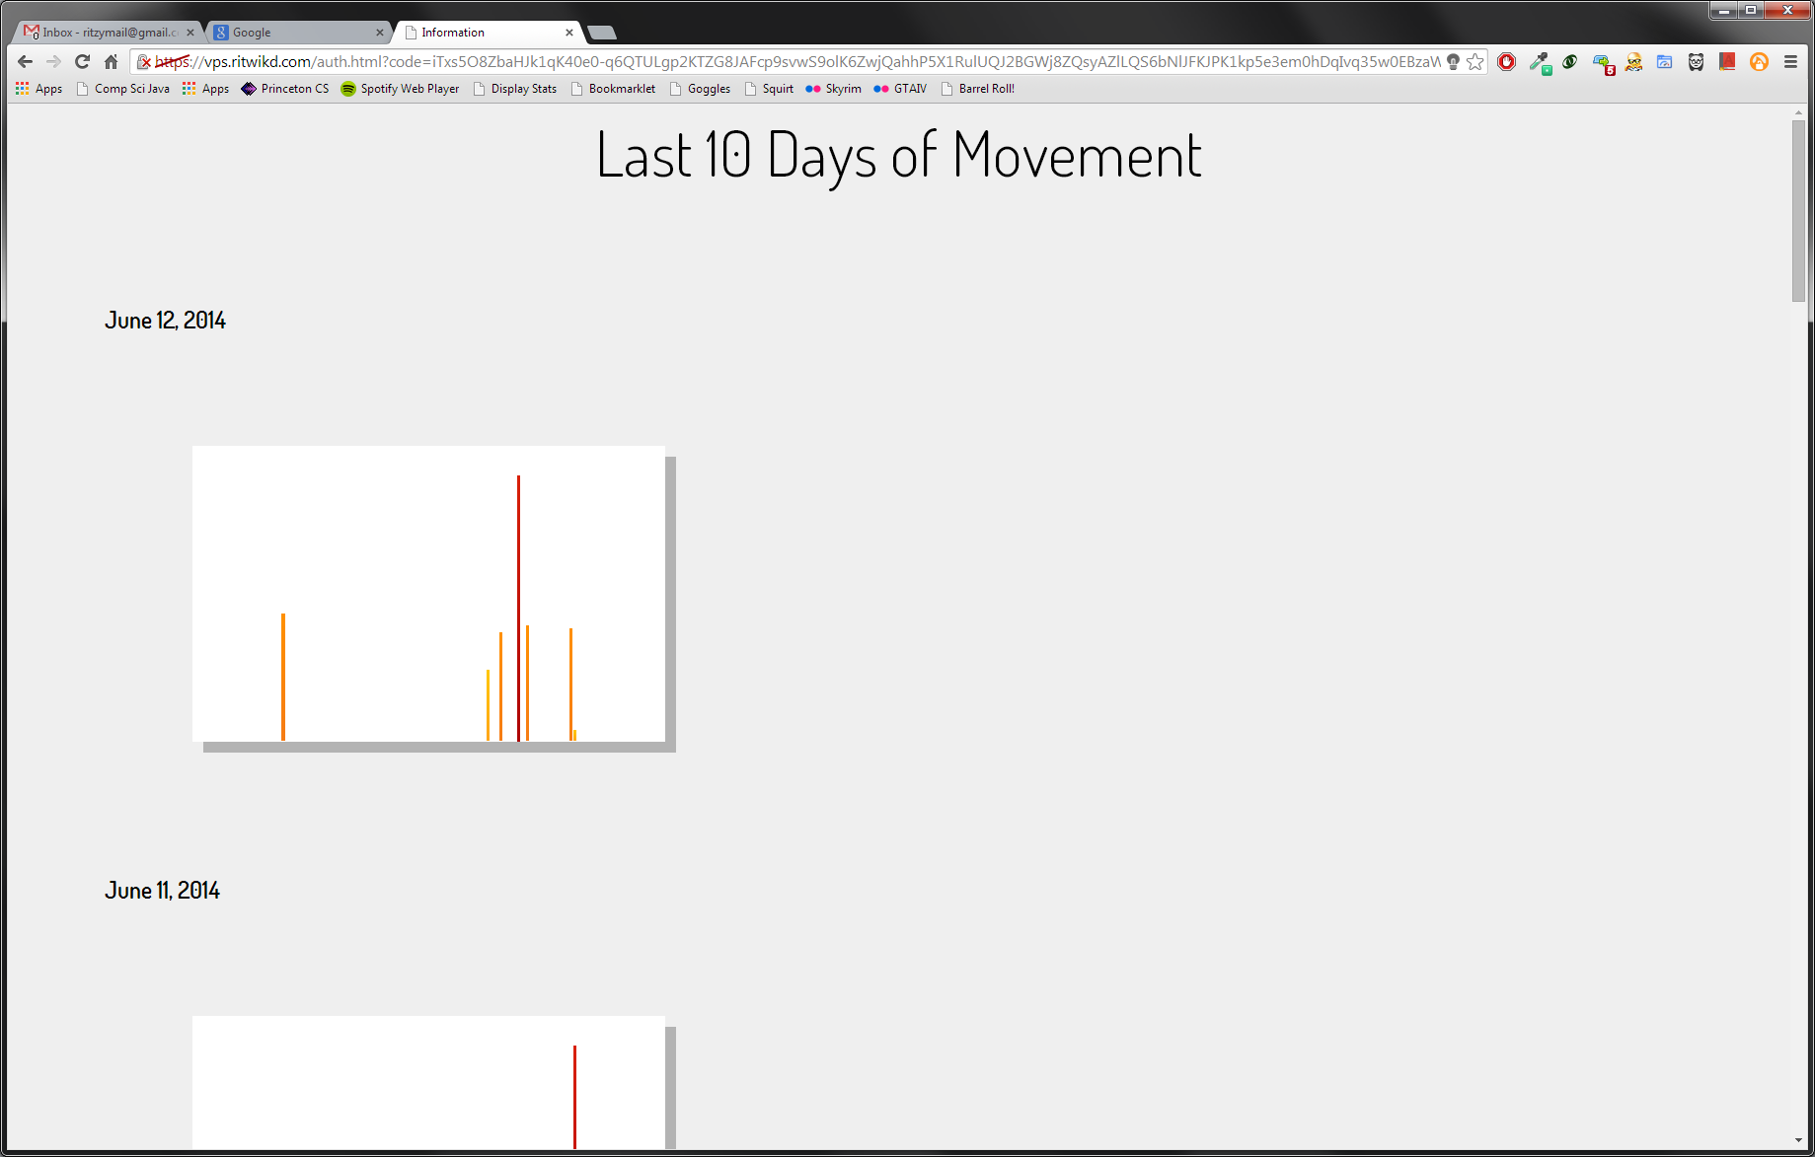
PART 4 – API DATA DISPLAY
Callback page received JSON data from server-side Python CGI script
Callback page parses JSON and injects data into HTML page
Caretaker can view data to make adequate decisions

Slide 10
DATA SPECIFICATIONS
Received in JSON format
Highest granularity is hourly
Total active and inactive time for hour
Total number of steps for hour
Longest active or inactive time for hour
Can be used to extrapolate lots of other data such as exercise or sleep time to help inform caretaker

Slide 11
FUTURE GOALS
Implement data processing in server-side Python CGI script(s)
Use frequency of data
Migrate web server framework from Flask to Django/Pylons for increased robustness
Migrate server off Digital Ocean VPS servers to dedicated machines to eliminate possibility of maintenance problems or limitations

